Slide 1

Topic – Choosing a Car
Project by: Ashley D’Silva, Amey Naik, Pornima Saraf, Siddharth Gajare

Slide 2

PROJECT OBJECTIVE
Finding the best suitable car based on the user's preferences

Slide 3

Introduction
Helps the user to find the best car based on his preferences.
Excel-based program
Has a big database of 50 cars
Result is based on analysis with utility function and Monte Carlo simulation.
Selects the best suitable car based on inputs as well as gives other car suggestions.

Slide 4
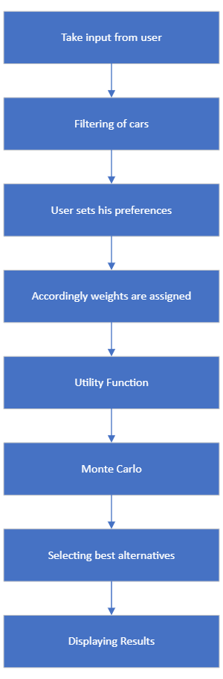
DSS FLOW CHART

Slide 5
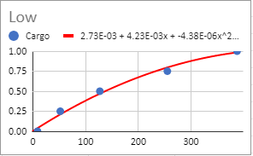
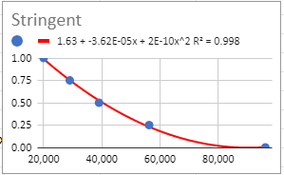
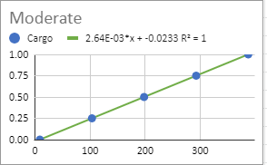
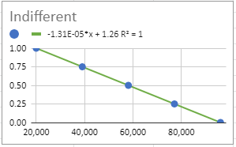
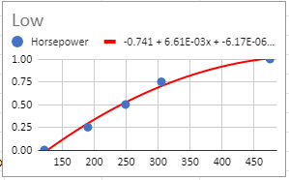
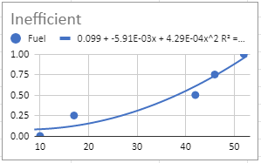
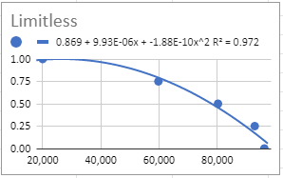
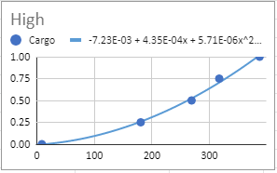
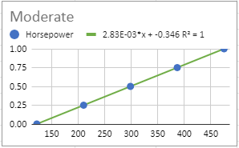
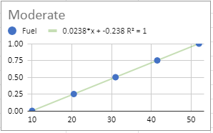
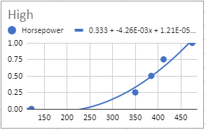
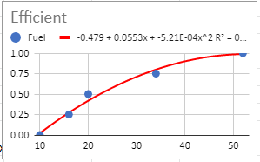
Program Logic
DSS
Cost
Horsepower
Fuel
Cargo
Stringent
Low
Efficient
Low
or
or
or
or
indifferent
Moderate
Moderate
Moderate
or
or
or
or
limitless
High
Inefficient
High
Attributes
Options

Slide 6
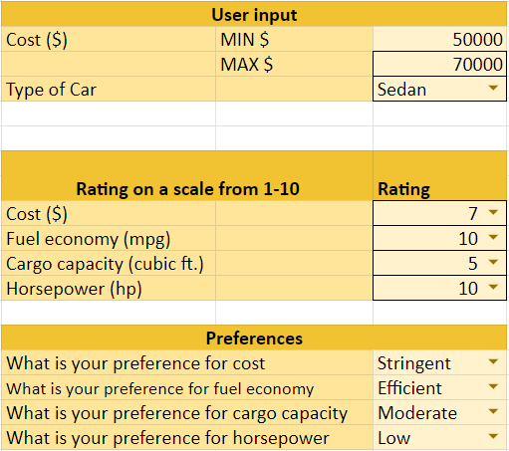
DSS Working
User Inputs and Preferences

Slide 7
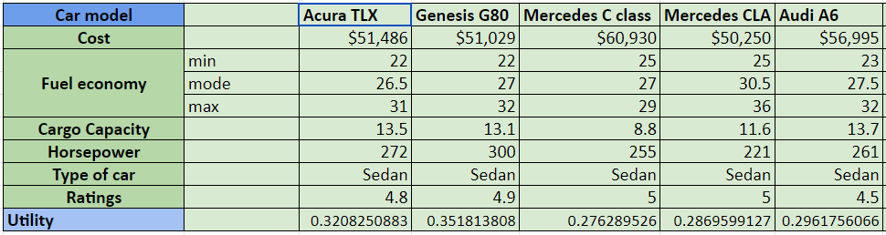
DSS Working

Slide 8
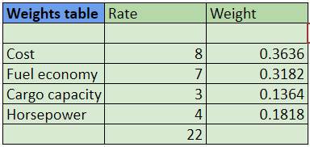
Weights
Based on the user preference, the values of the weights are calculated.

Slide 9
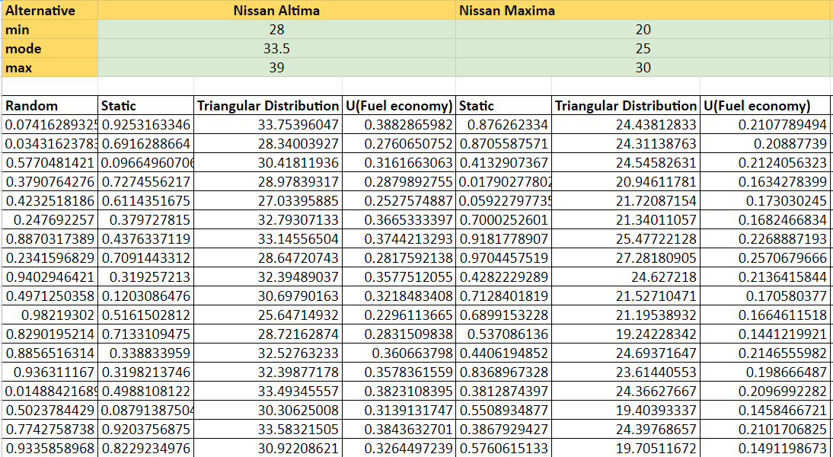
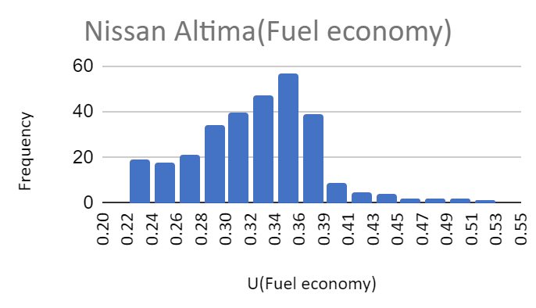
Monte Carlo Simulation

Slide 10
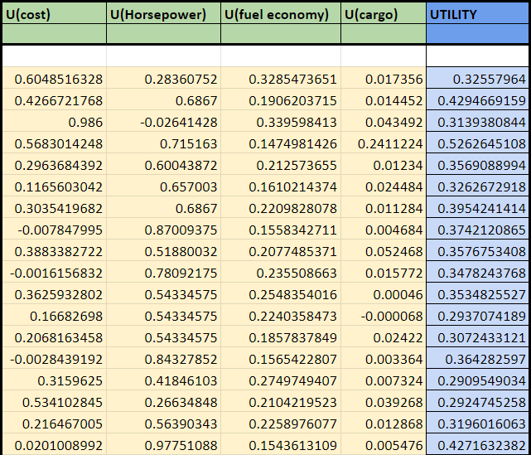
Total Utility
Selecting the best car as per the values of Utility

Slide 11

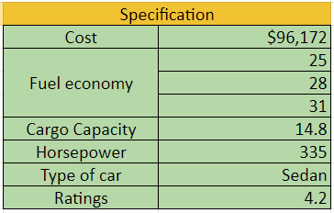
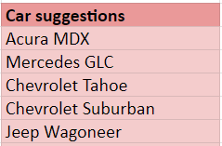
Results
Based on the user’s inputs, the best suitable car is then displayed with all its features.
The DSS also offers recommendations for alternative vehicles.

Slide 12
Test Drive
https://docs.google.com/spreadsheets/d/1AiSo8-37Ji36doj0pOIXwMyAPWsYchfVtKedj7YrowA/edit?usp=sharing

